Slide 1
WORLD TRADE CENTER TAMPA BAY

Slide 2
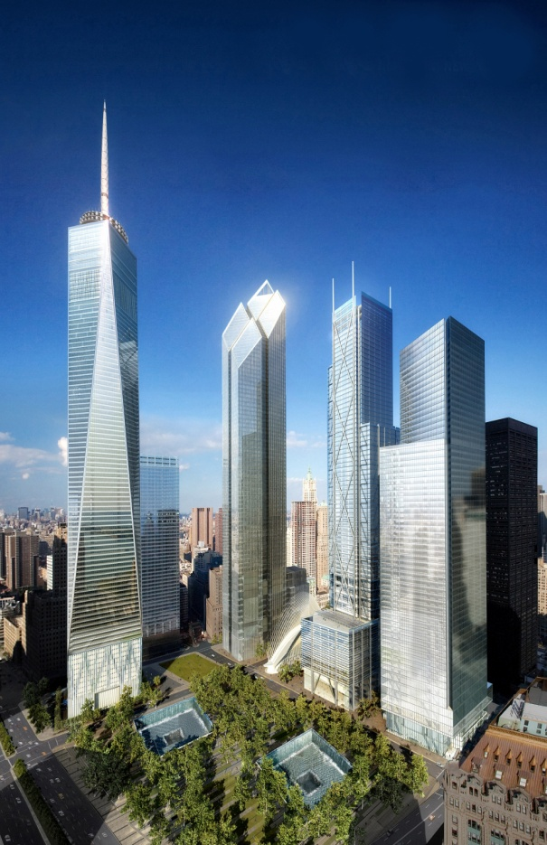
World Trade Center Association
The World Trade Centers Association (WTCA) headquartered in New York City oversees 326 World Trade Centers located in North America, Central and South America, Europe, Africa and the Middle East, and Asia and the Pacific. World Trade Centers branded properties and WTC trade service organizations are active in more than 92 countries, connect 15,000 professional staff members and represent over 750,000 business members worldwide.
WWW.WTCTAMPA.ORG
WWW.WTCA.ORG

Slide 3
The WTCA serves as an “international ecosystem” of global connections, assets and integrated trade services under one umbrella, dedicated to:
• Encouraging the expansion of world trade
• Promoting international business relationships
• Fostering mutual assistance and cooperation among ` members and regional stakeholders.
WTC Tampa Bay brings together businesses and government agencies involved in international trade, provides essential trade services and stimulates the economy of the region it serves.
WTCA Member meetings annually in NYC, China and selected city (Accra 2022).

Slide 4
The MISSION of the World Trade Center Tampa Bay has evolved around prominent service areas to advance Tampa Bay region as key business center:
Education: Bringing knowledge to the community through Lecture Series, Speaker Bureaus, Panel Discussions and Trade Missions.
NCUSCR (China Town Hall)
Global Help Desk
Bannockburn Forex
Communication: Sharing valuable international resources, trade information and updates, as well as facilitating communication among international groups.
EX-IM Bank - Export Credit Insurance program
US Commercial Service & SBA – Export Plan
Collaboration: Connecting membership with global contacts to facilitate and amplify trade and international business.
B2B trade missions – Summer 2021 Dubai
B2B reverse mission. – Fall 2021 Switzerland
AgTech Summit – Winter 2021
Inquiries for raw materials e.g. wood, lubricants, food stuffs
Notes:
Through comprehensive international trade services and key global contacts, WTCTB’s goal is to facilitate and expand trade for regional and worldwide clients. As a powerful voice for business growth and economic prosperity, the WTCTB is dedicated to leading the Tampa Bay region into a new era of international trade through trade shows, missions, special events, educational programs and other forms of assistance. World Trade Center Tampa Bay , provides a world-class portfolio of international trade services and key global connections to help the Tampa Bay region’s corporate and government partners succeed in global markets, expanding the economic growth of the seven counties as a whole.

Slide 5
collaboration
University of Tampa, International Programs
Hillsborough County Economic Development
Pinellas County Economic Development
Central Florida Development Council
Pasco County Economic Development Council
Sarasota County Economic Development Council
Citrus County Economic Development Authority
Hernando County Economic Development
Bradenton Area Economic Development Corporation
Enterprise Florida, Inc.
U.S. Commercial Service
Visit Tampa Bay
USF Business School
National Committee on U.S.-China Relations
To name only a few …

Slide 6
IMPORT & EXPORT
IMPORTERS
Assist foreign companies entering US marketplace (”soft landings”)
Market intelligence (market competition, regulation, conditions)
Support B2B (legal, accounting, warehouse, distribution)
EXPORT
US government support (plan & financial)
Market intelligence
B2B contacts

Slide 7
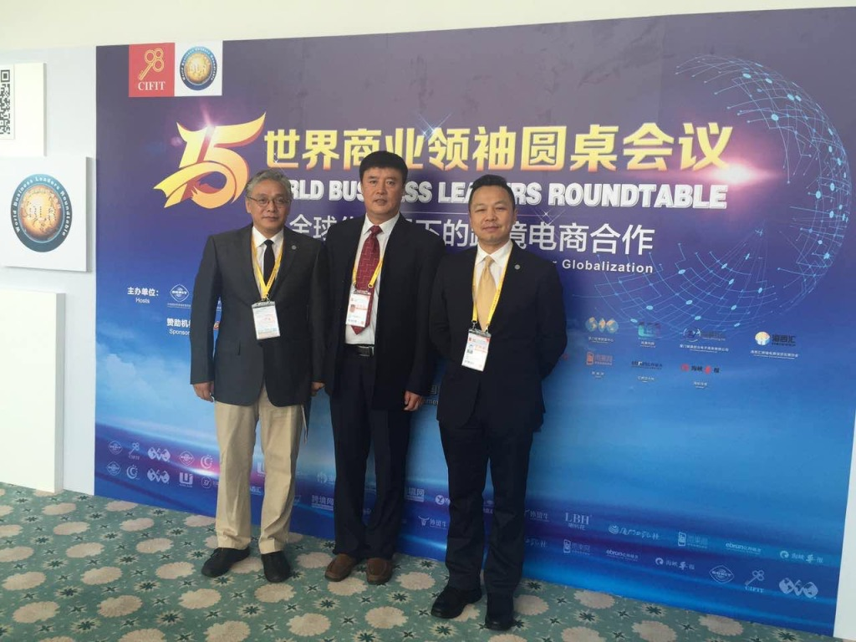
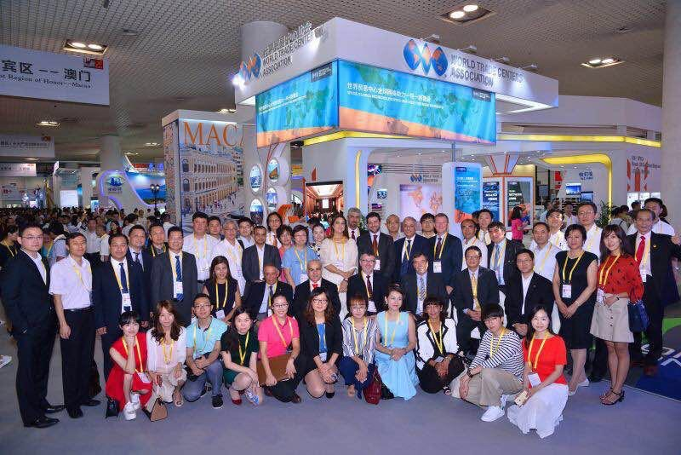
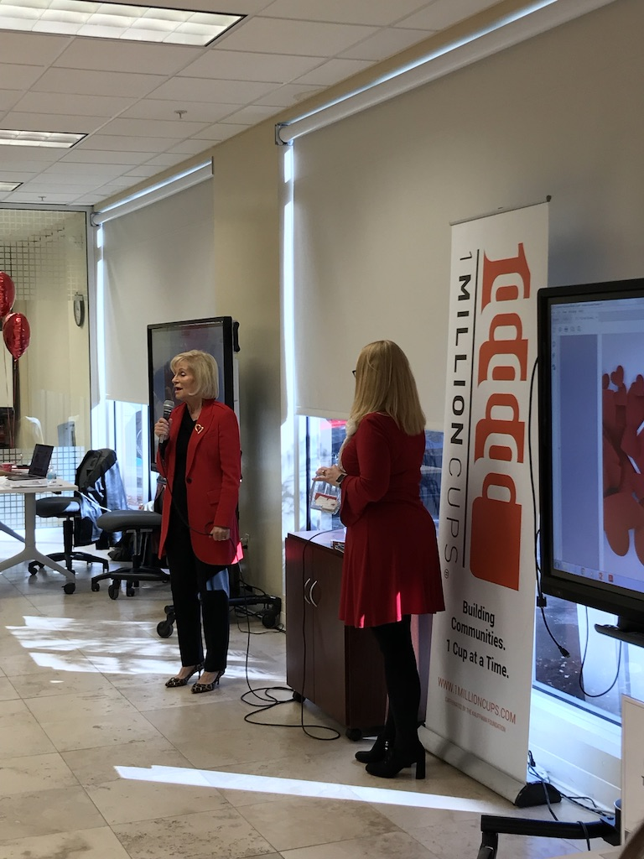
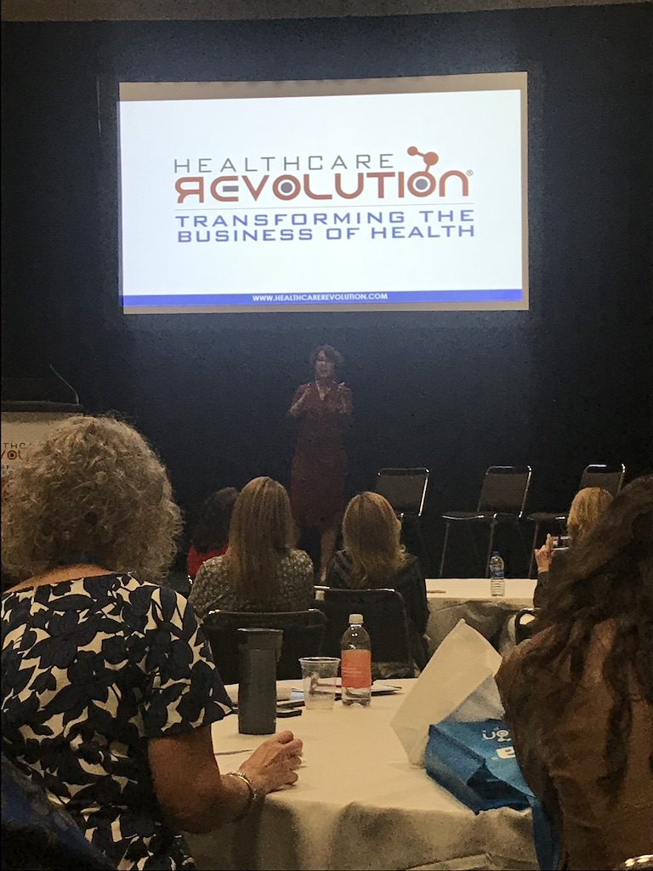
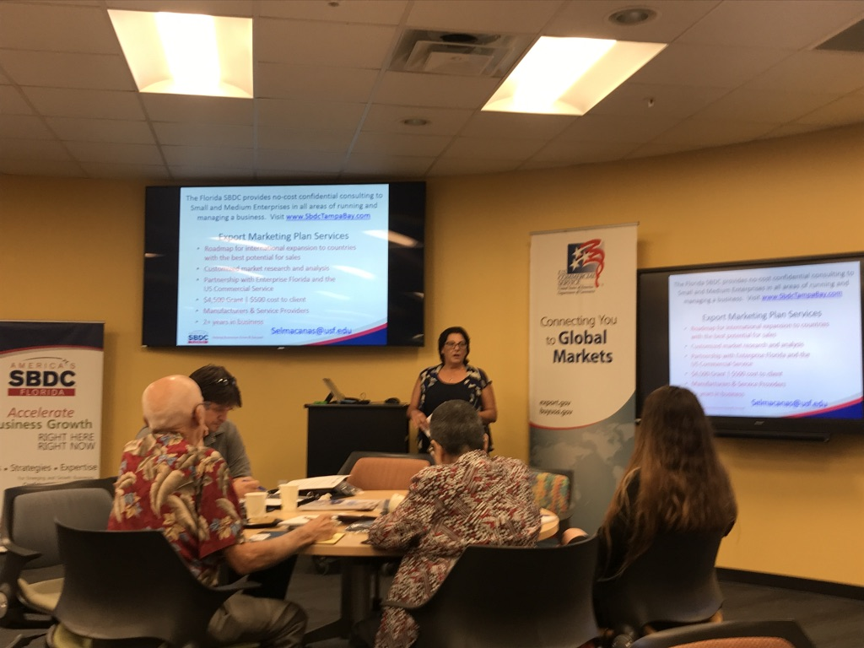
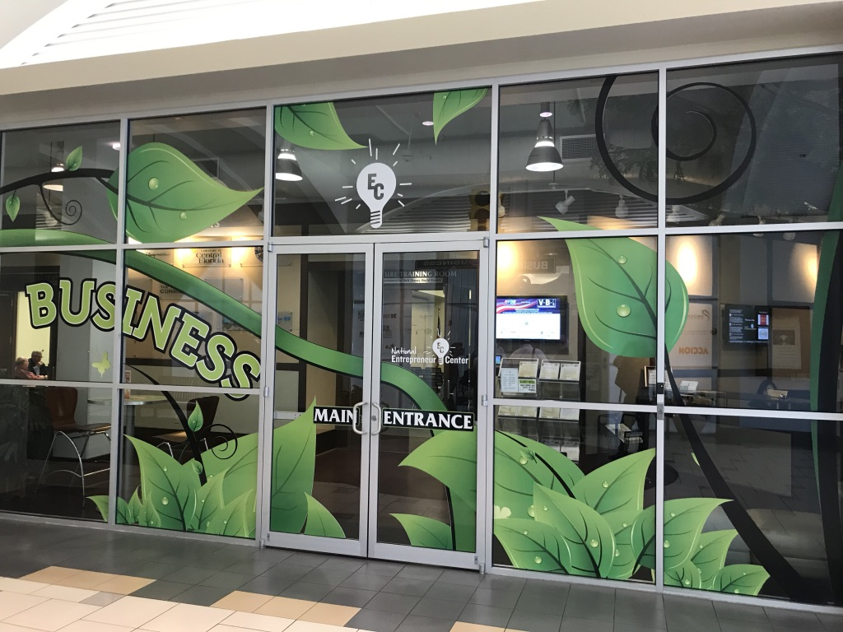
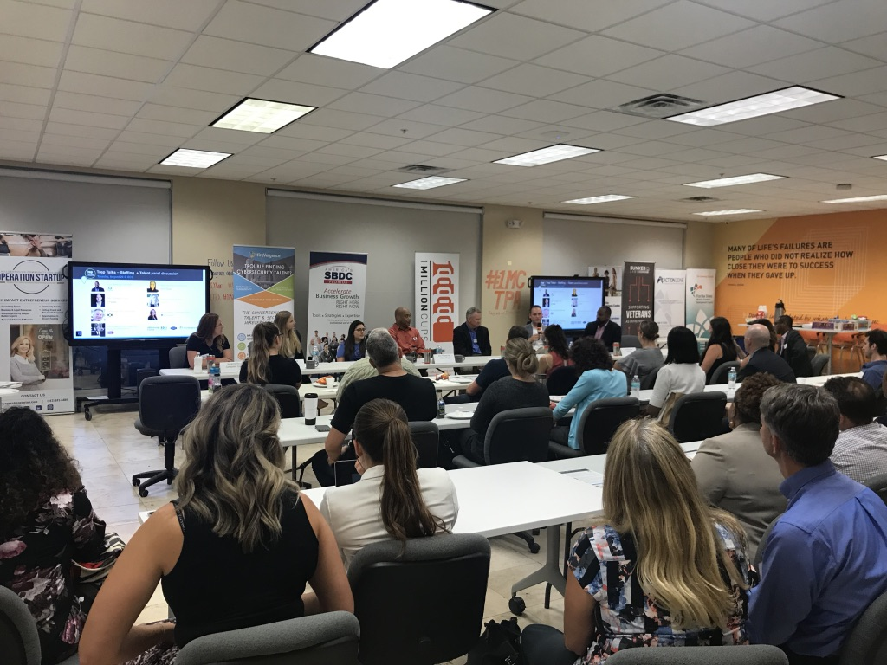
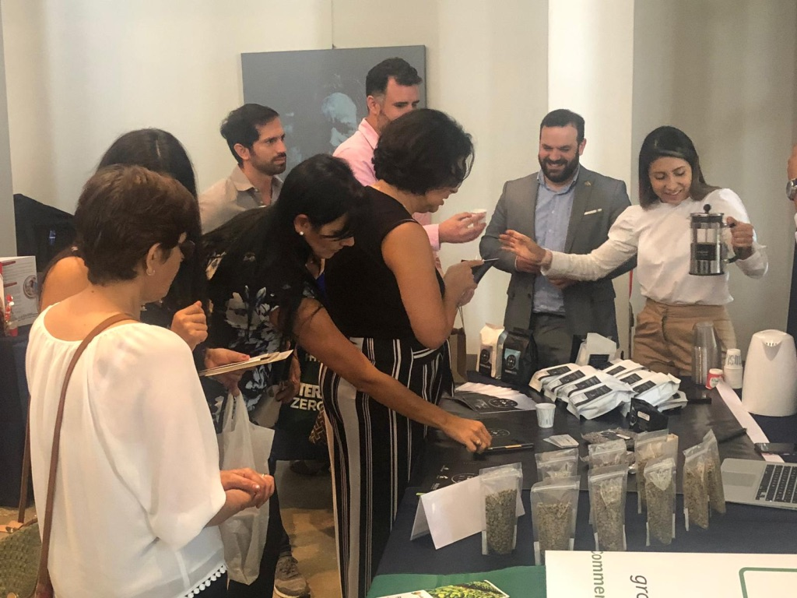
Local & International Events

Slide 8
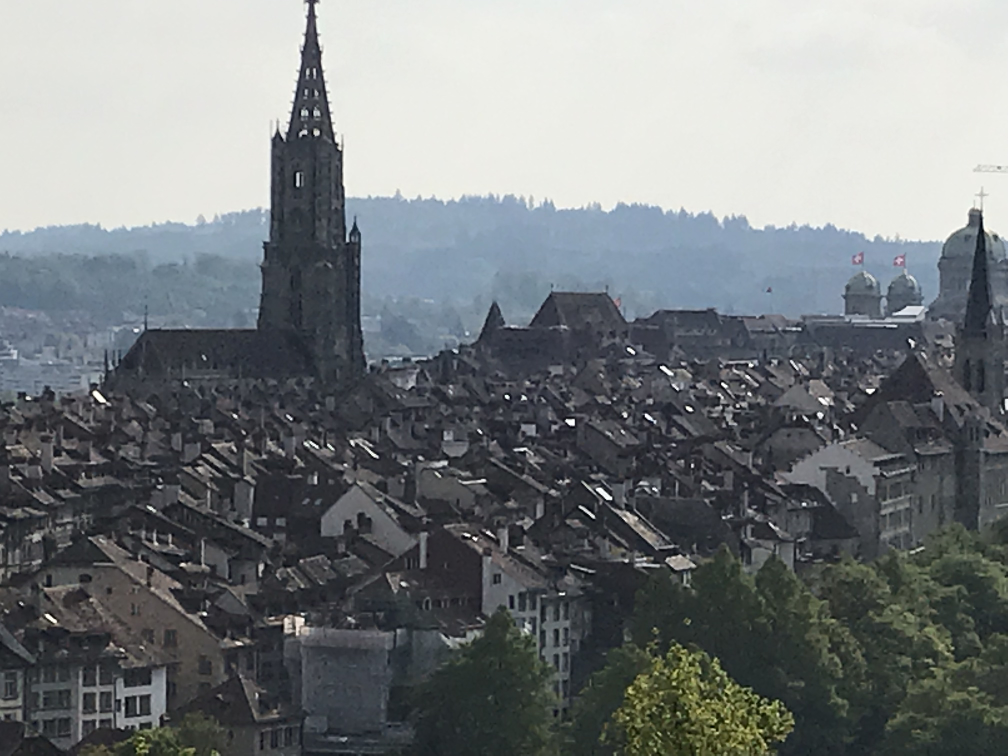
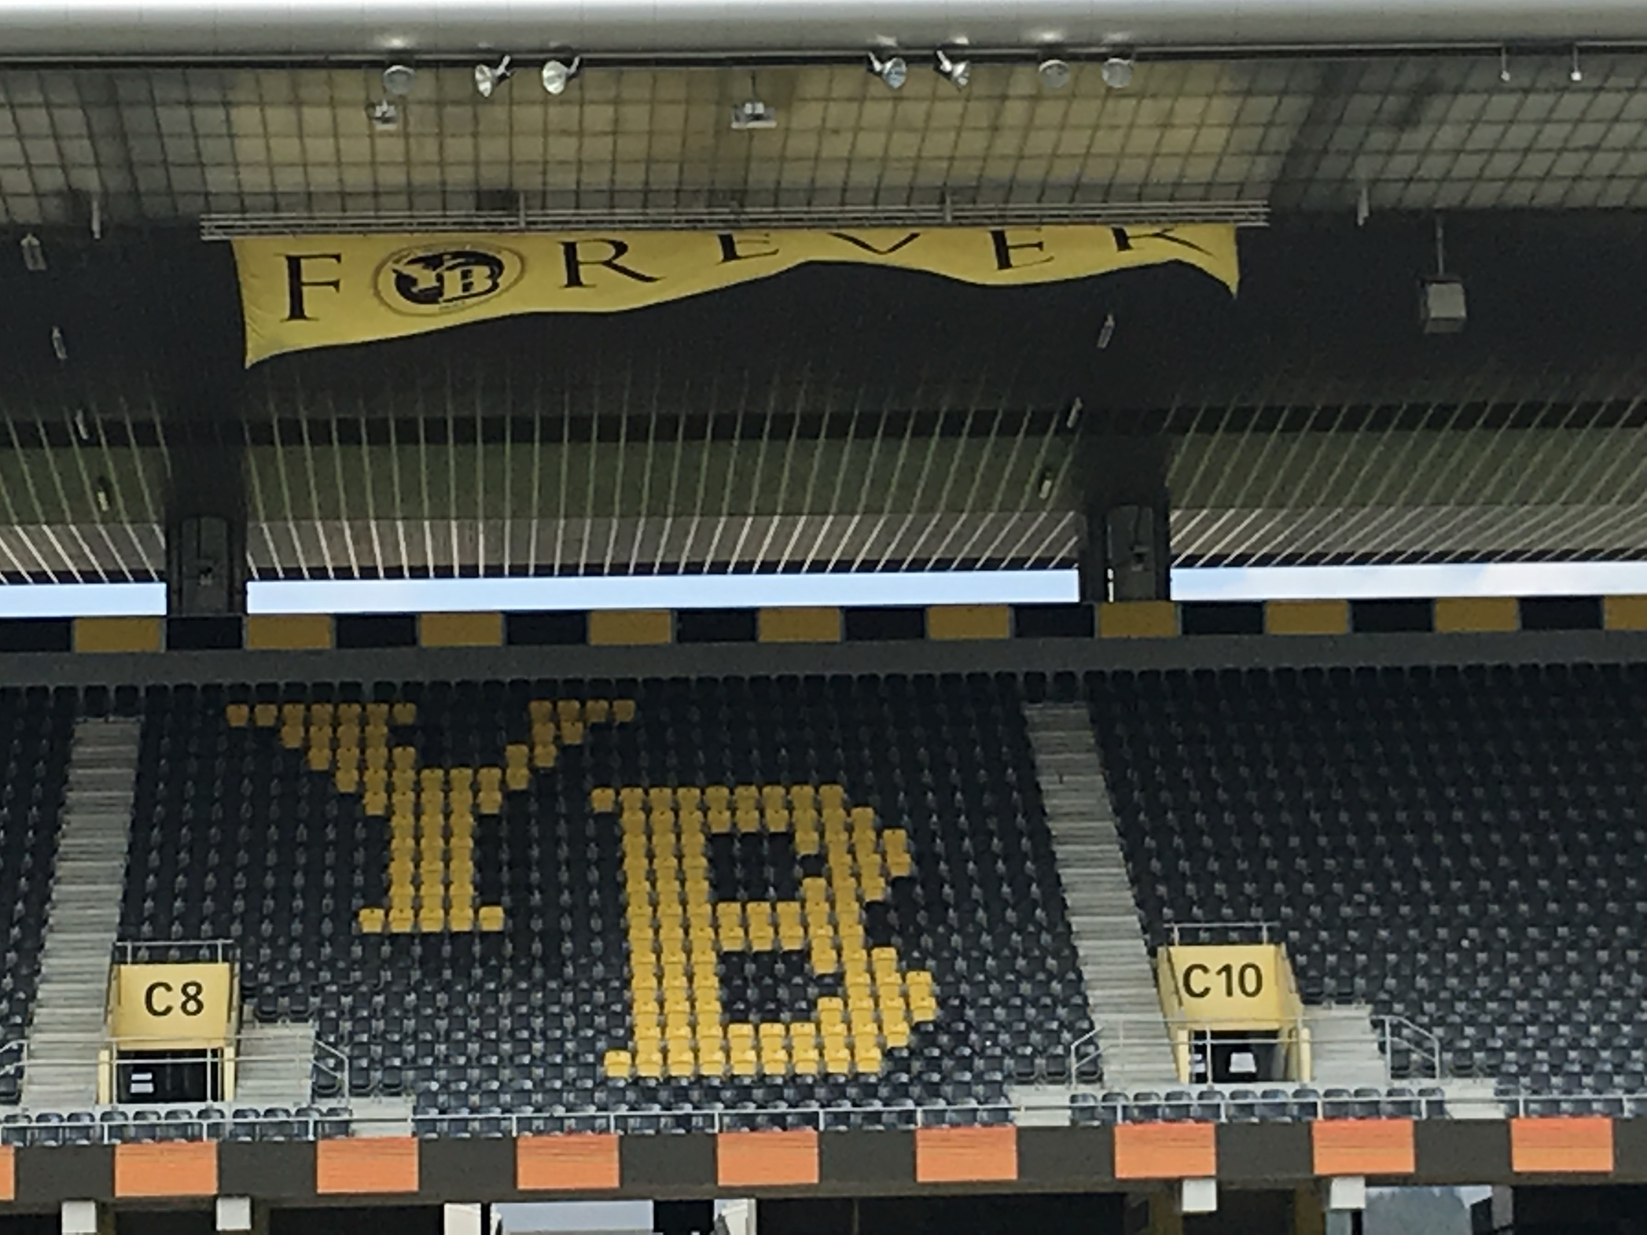
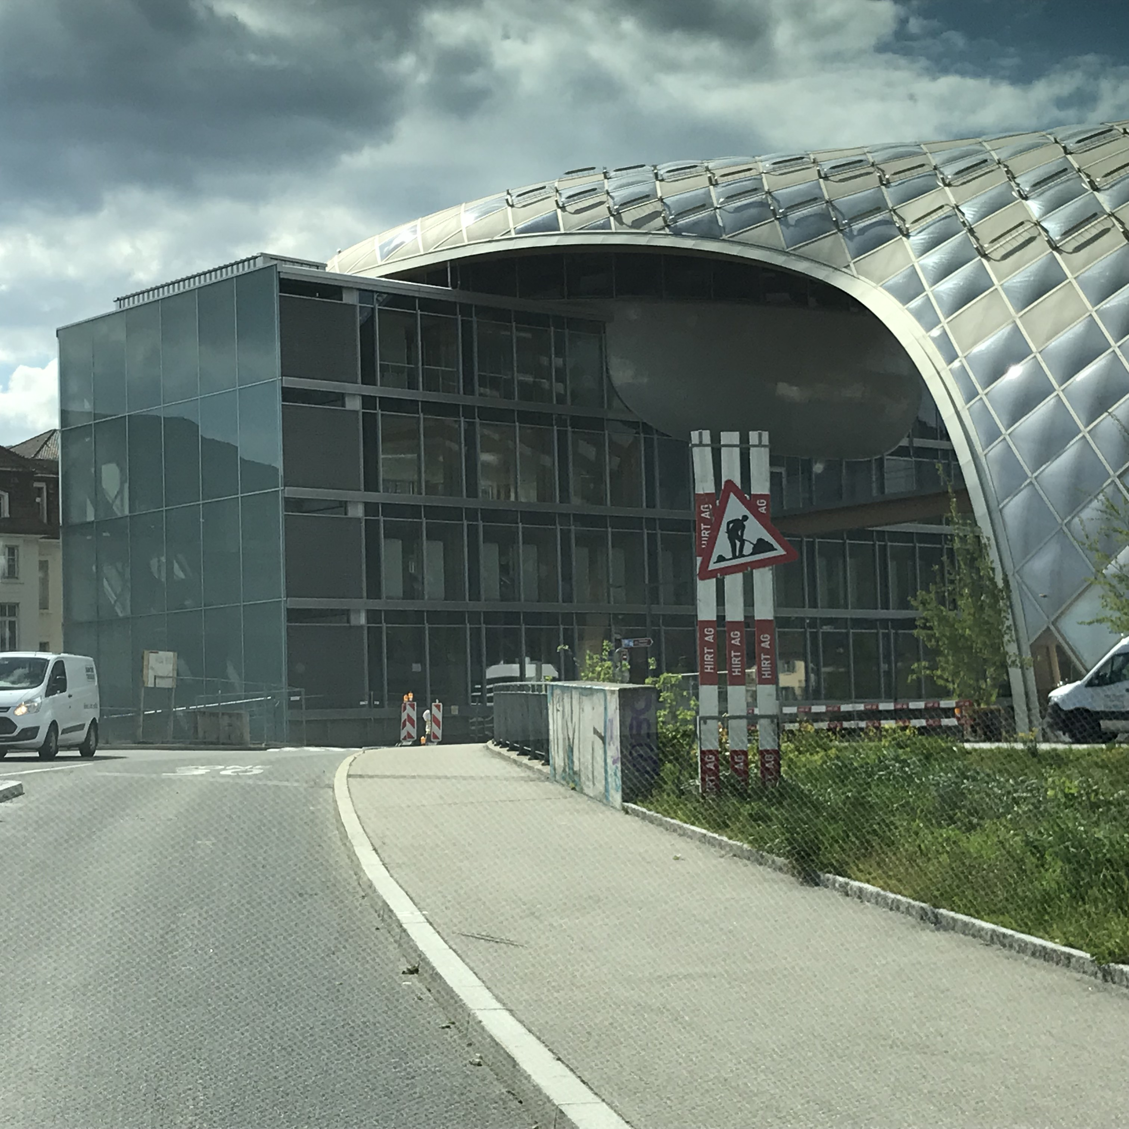
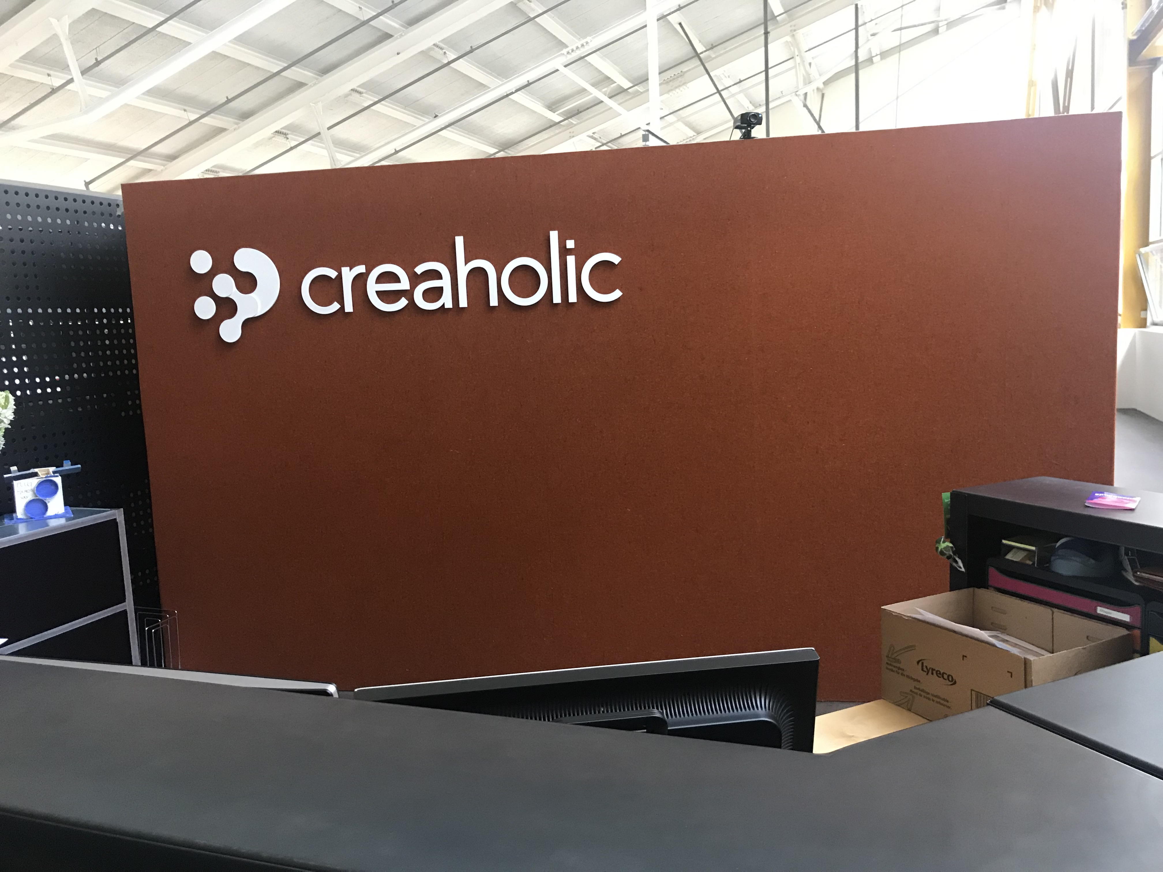
Switzerland
May 2019

Slide 9
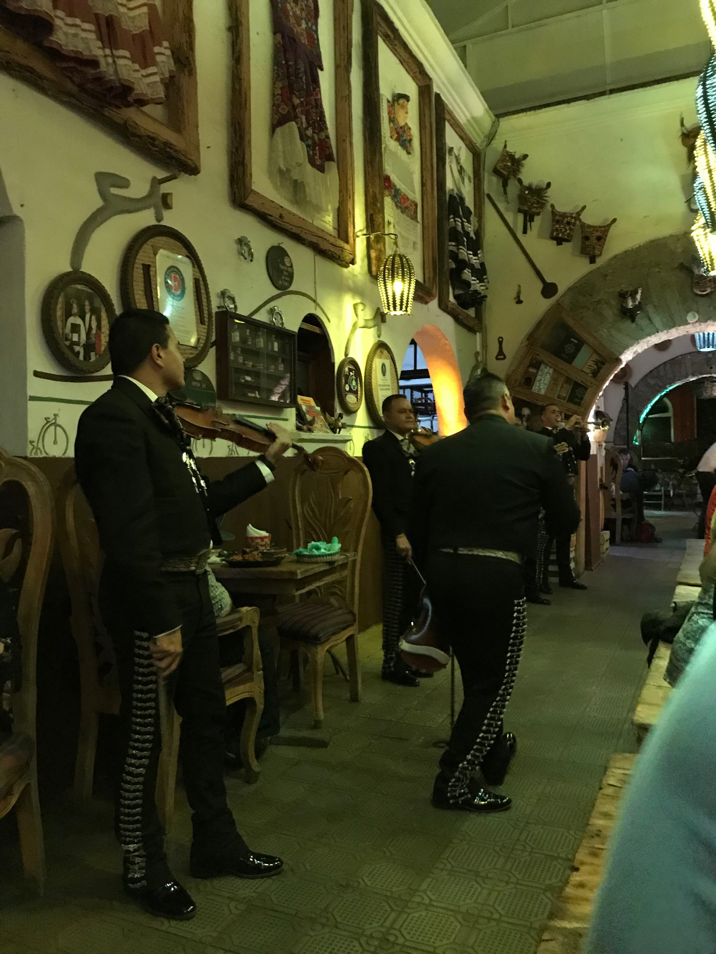
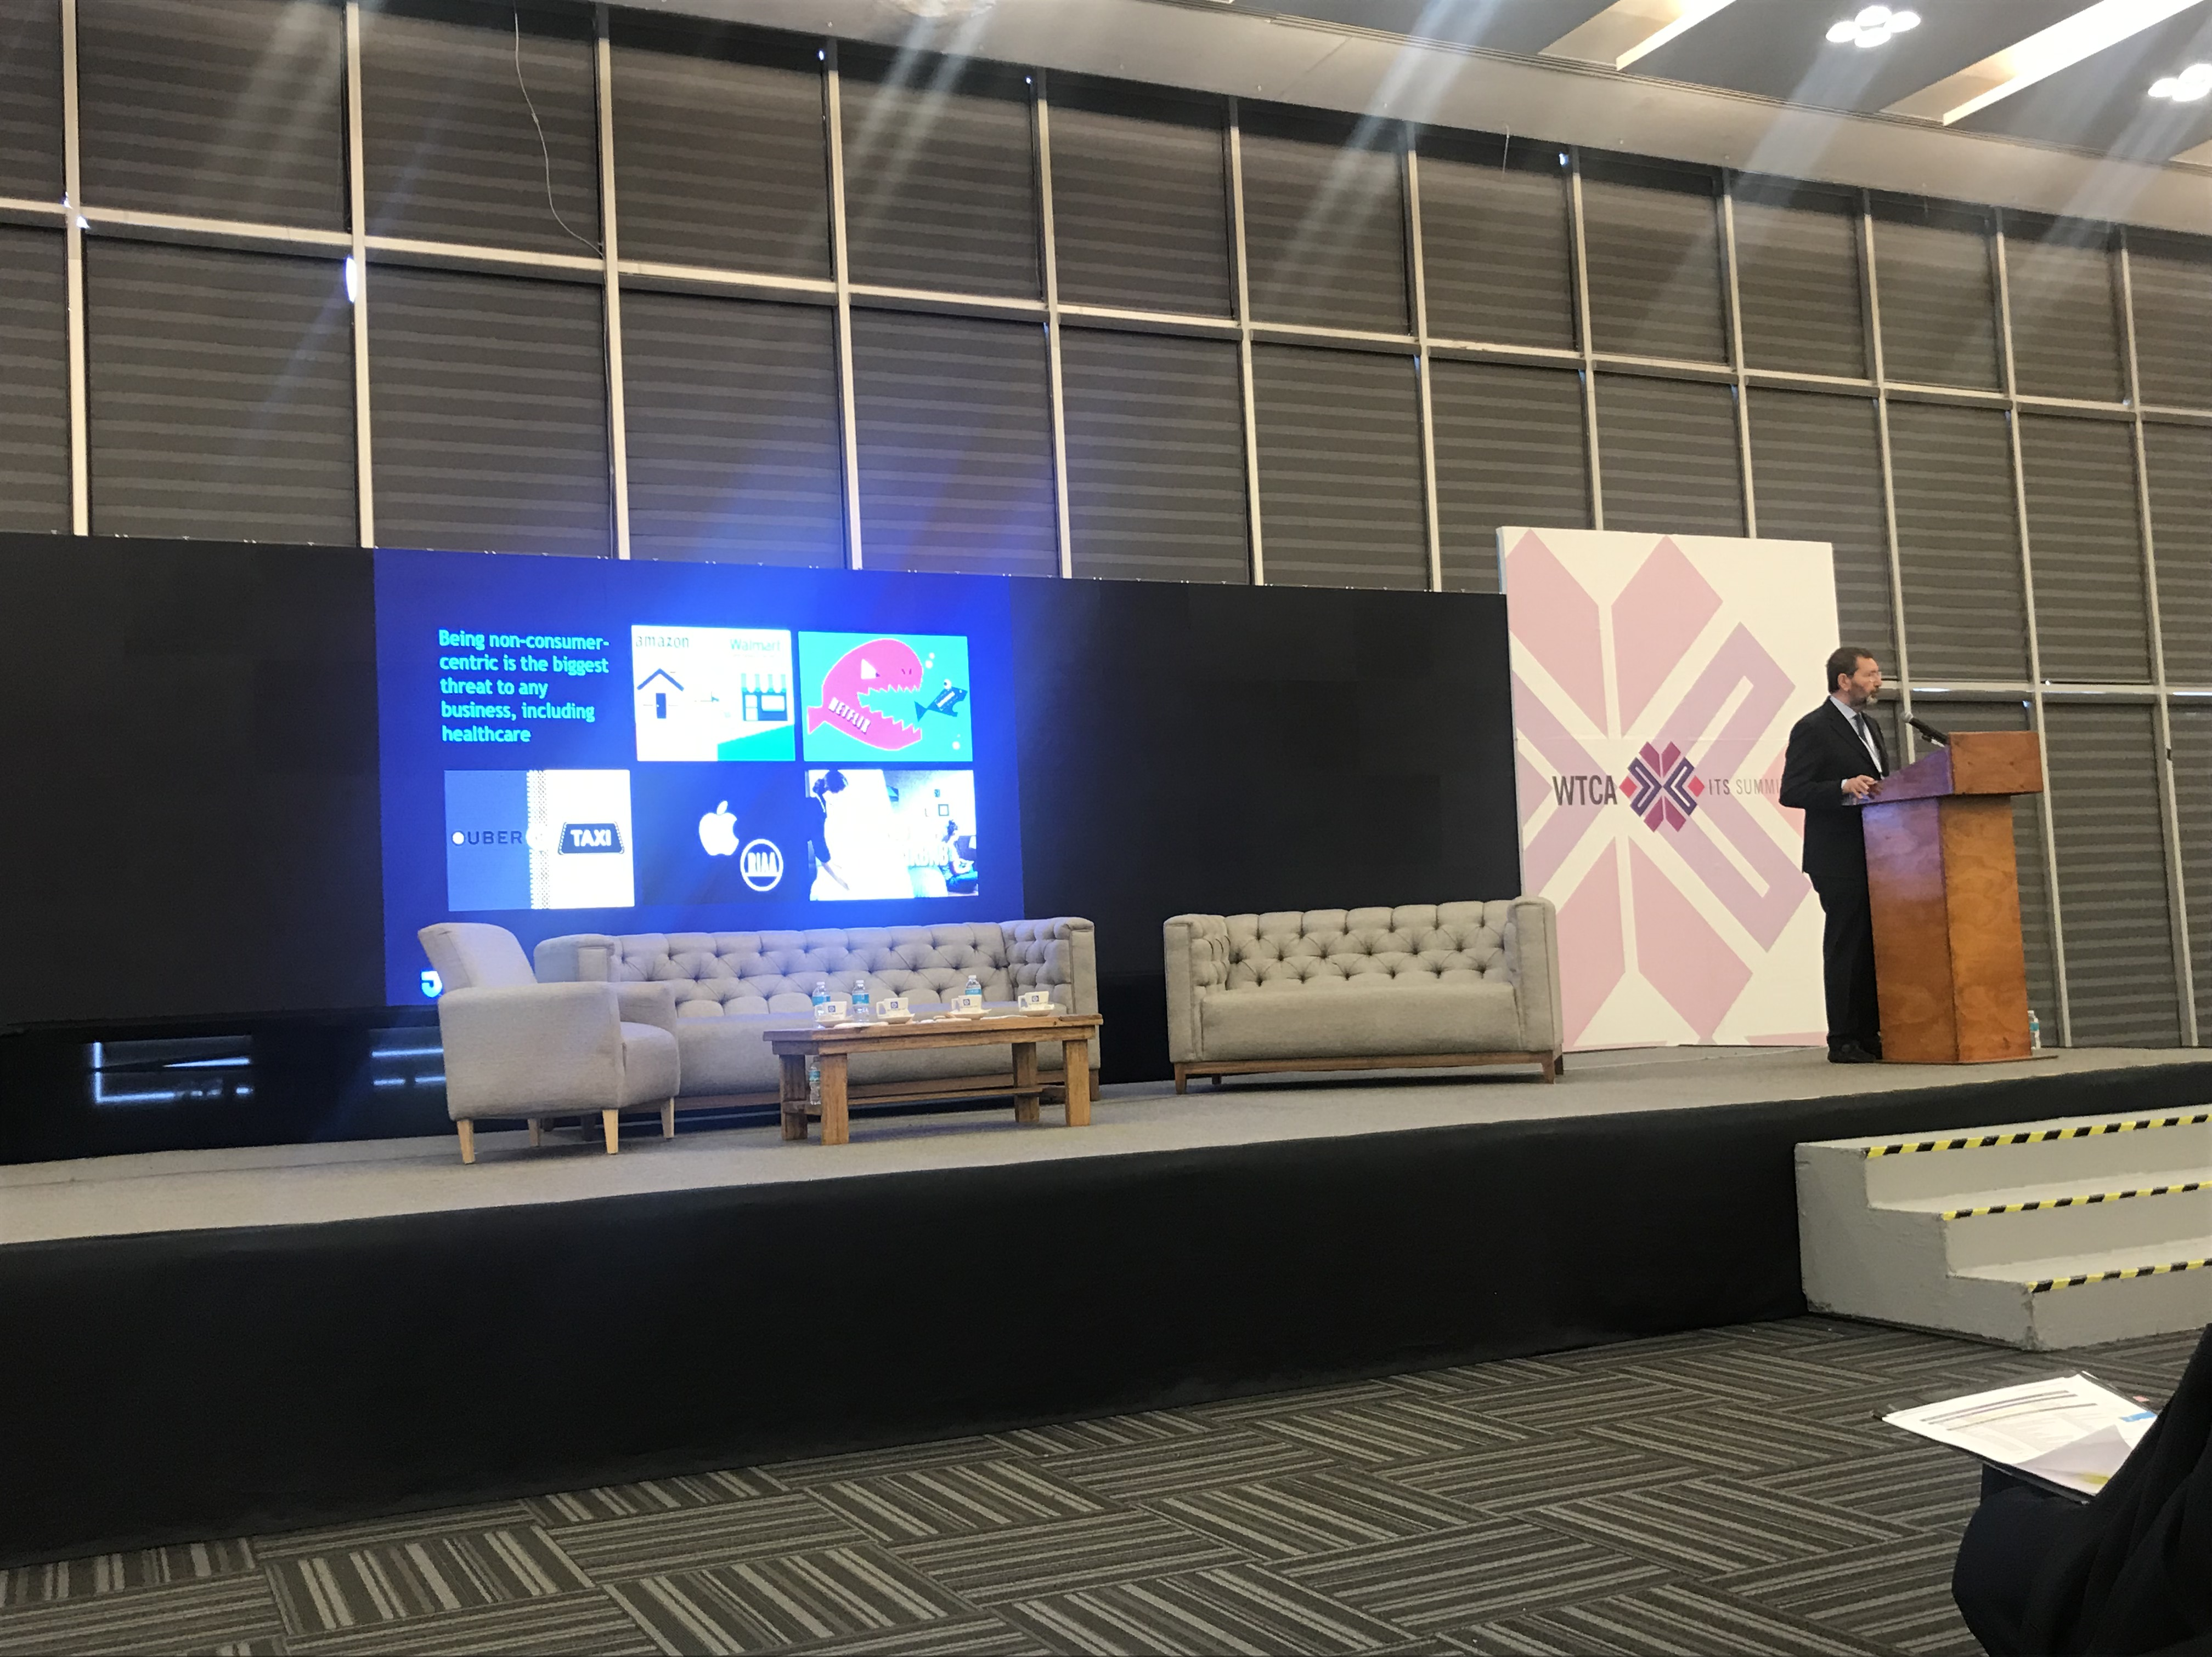
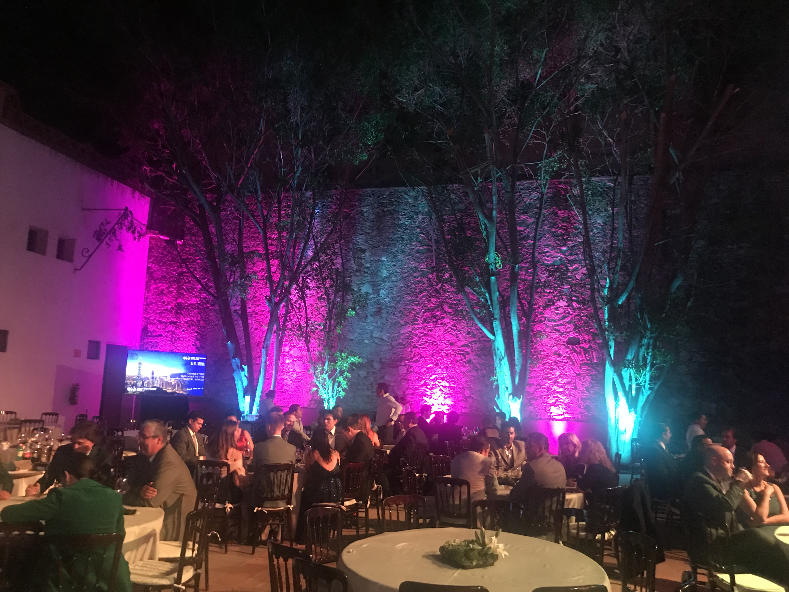
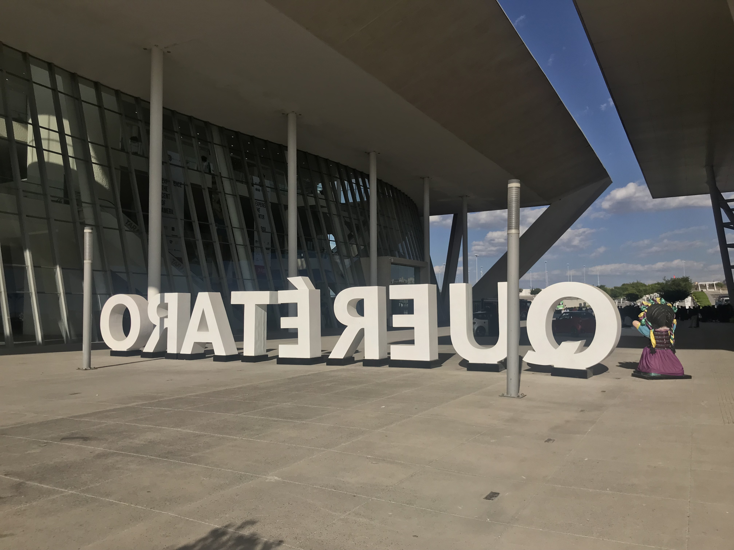
Queretaro 2019

Slide 10
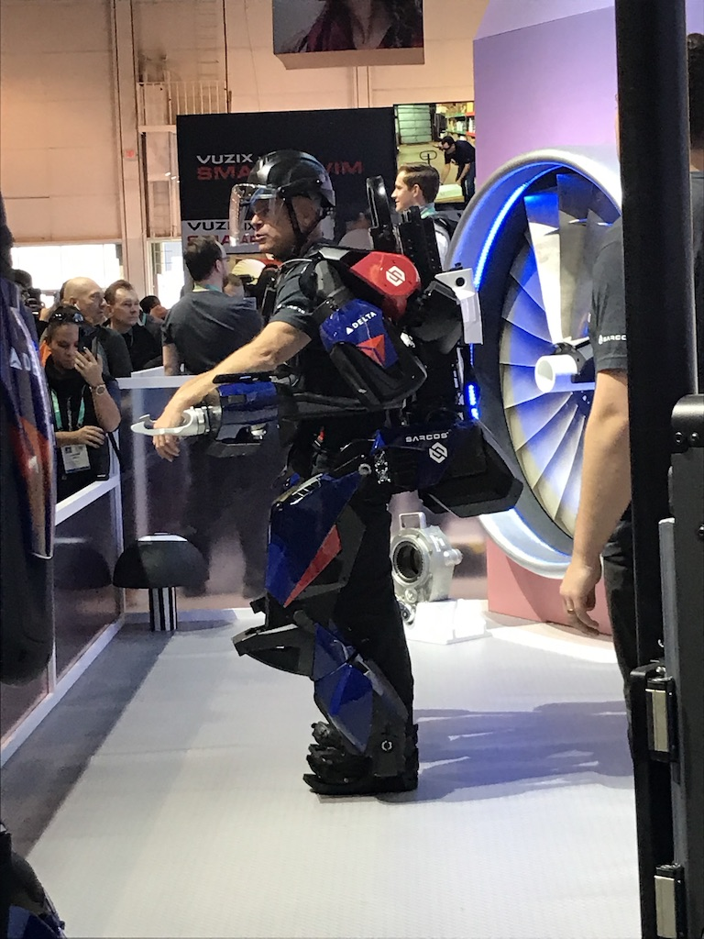
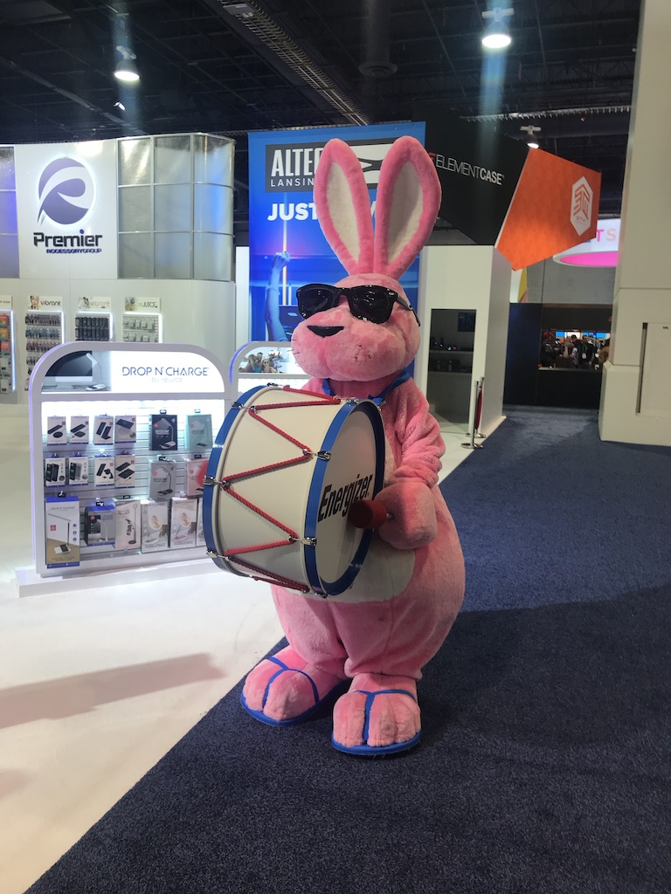
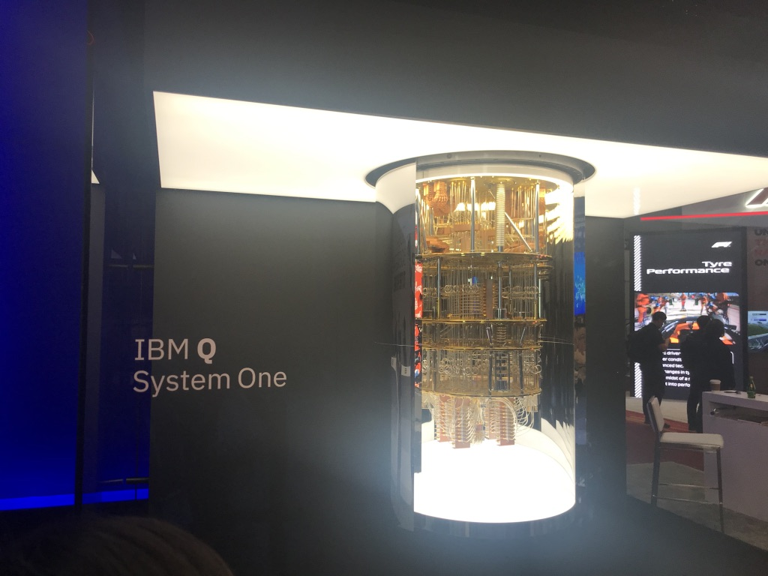
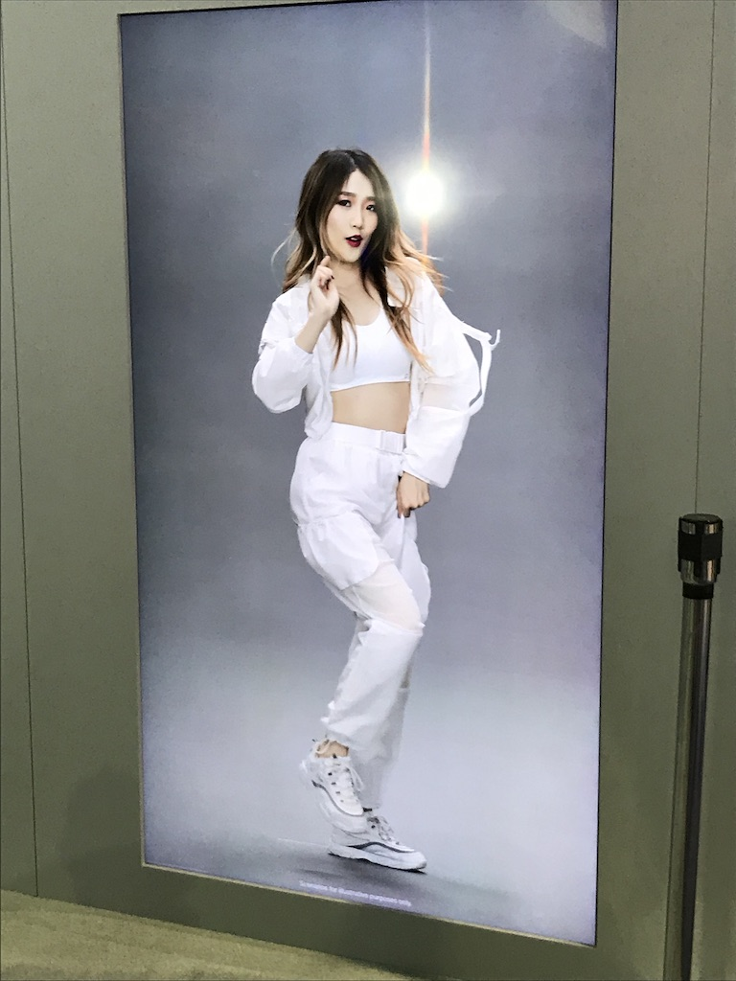
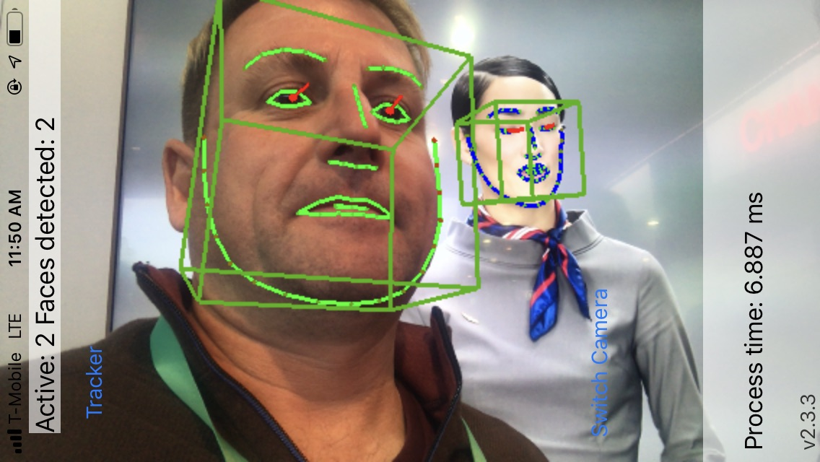
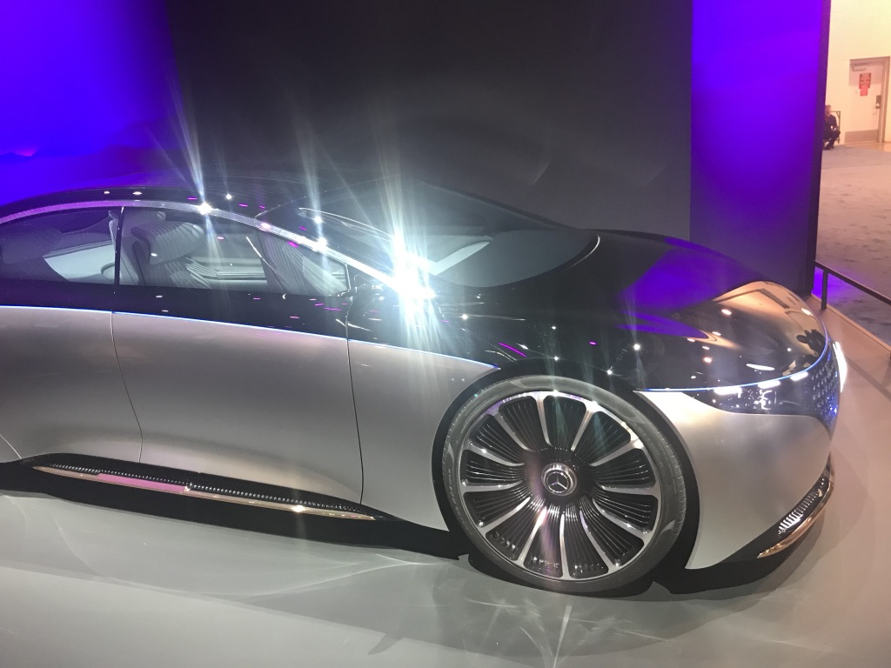
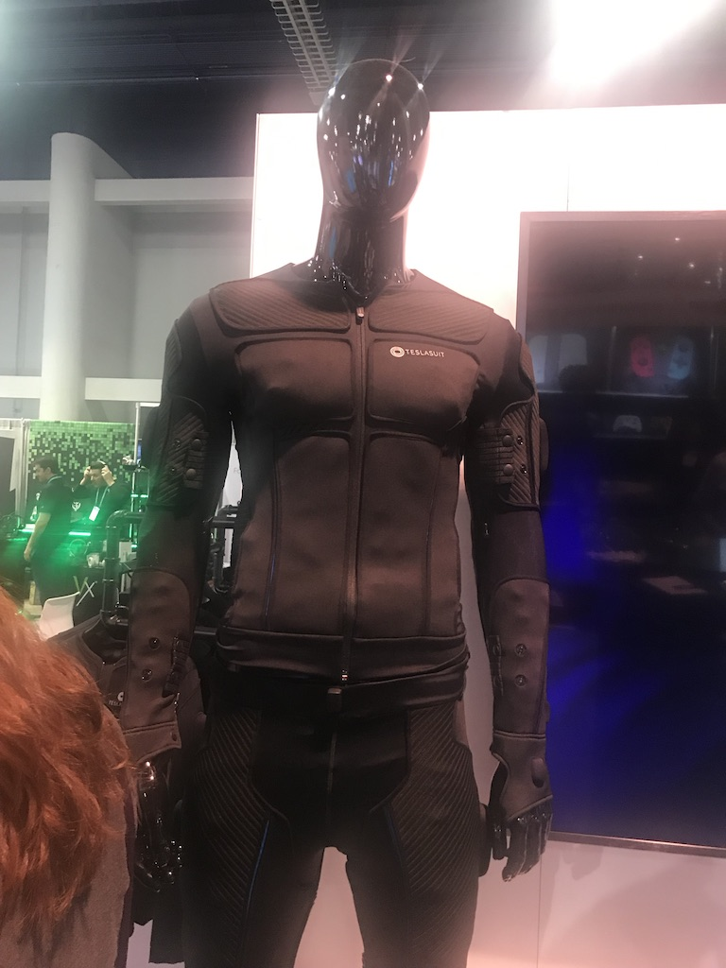
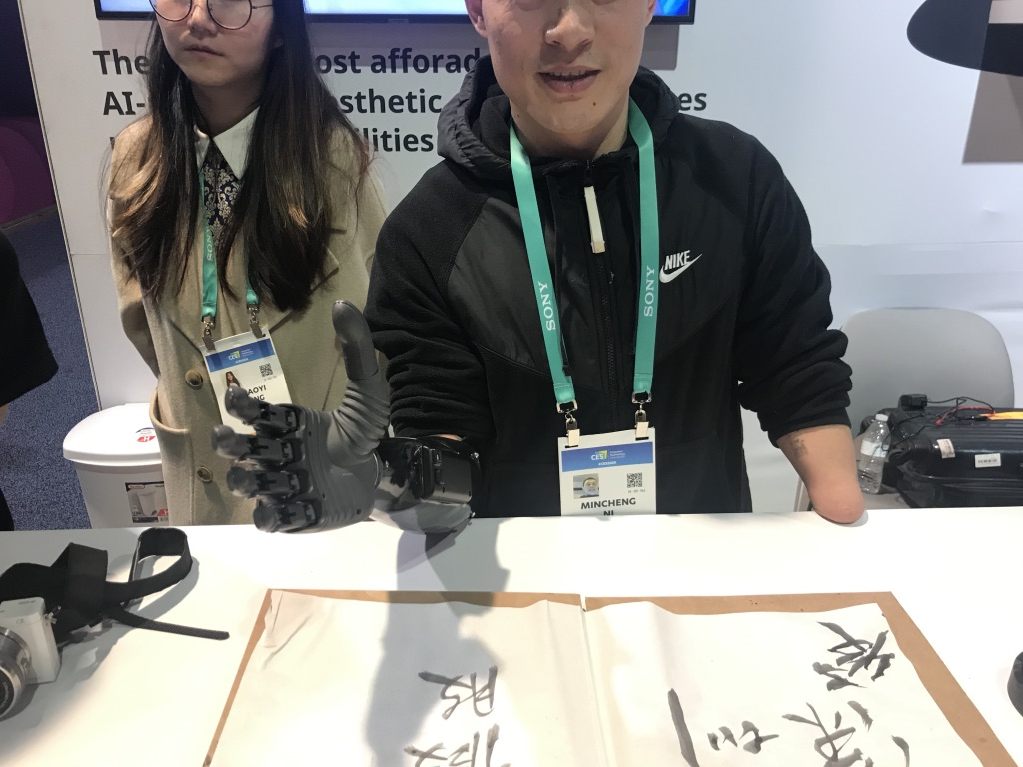
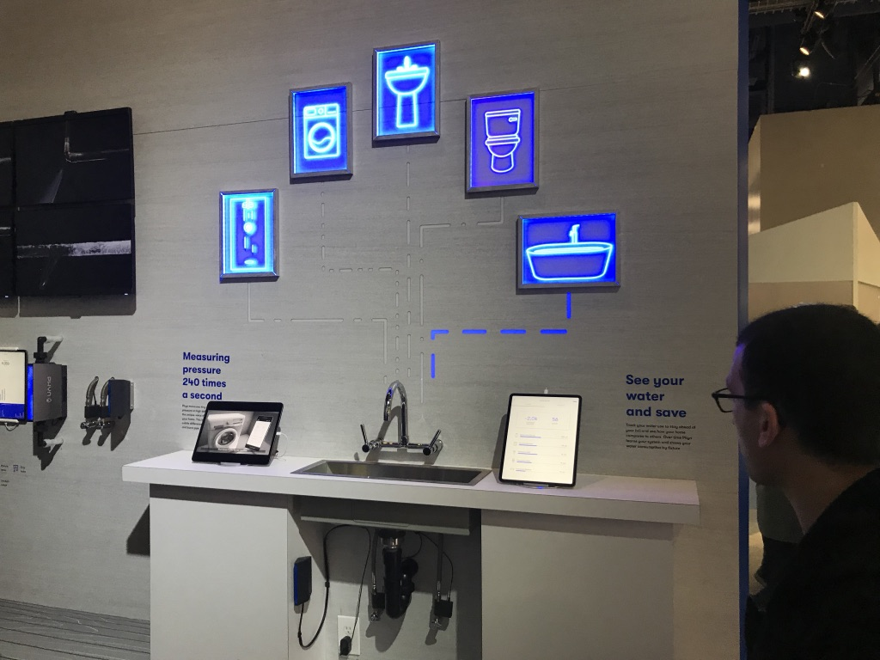
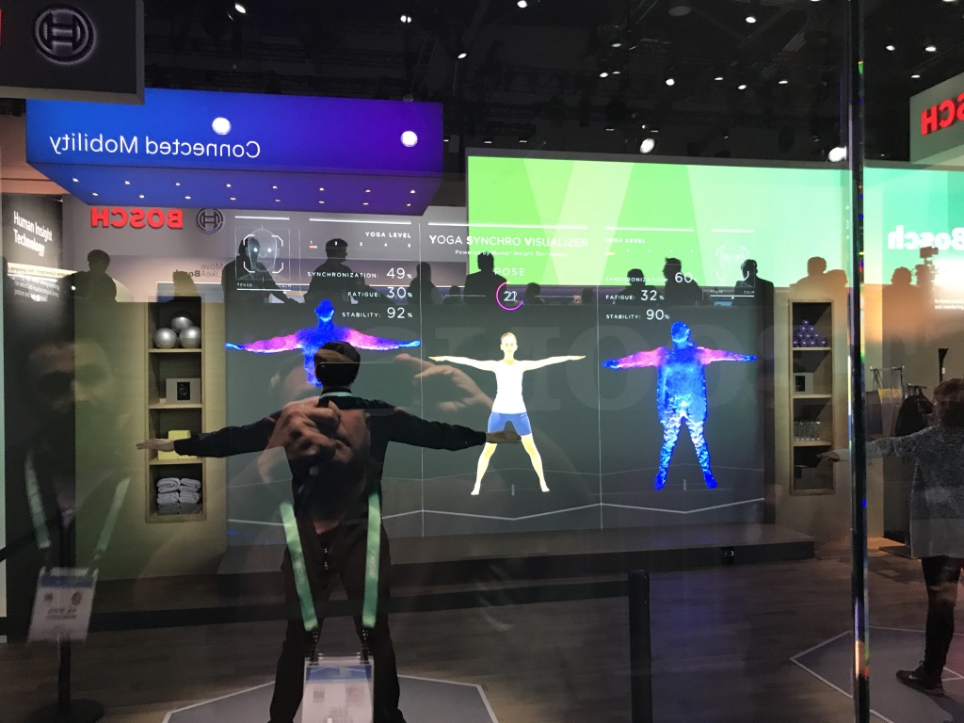
Las Vegas
Consumer Electronic Show 2020

Slide 11
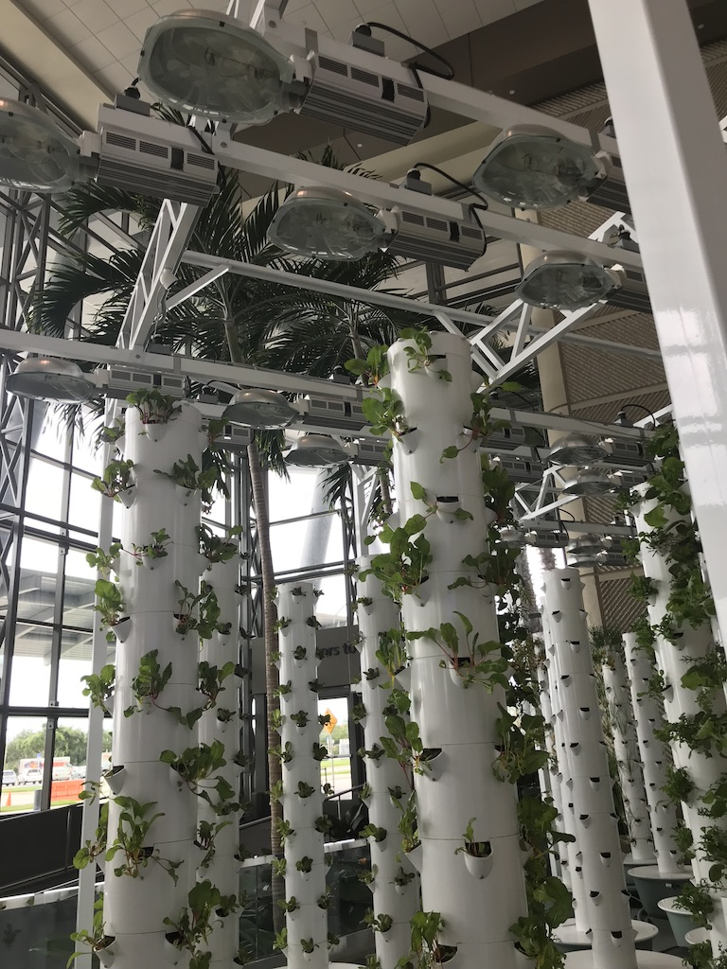
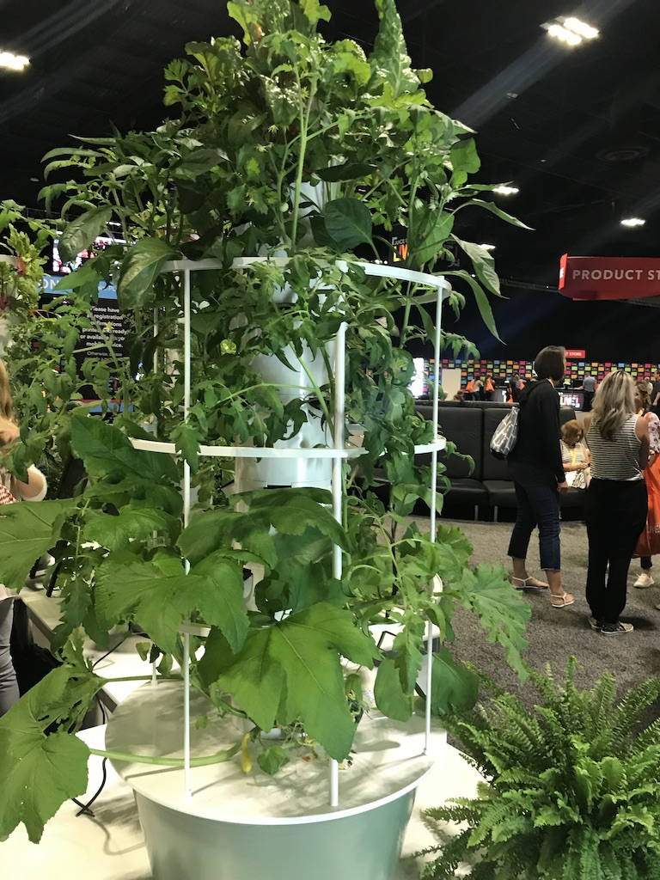
Florida International Food Technology Summit October 2021 (virtual)

Slide 12
Virtual GA 2021
51st General Assembly
April 23-25, 2021, the General Assembly will focus on “Connecting Business to the Digital World” and will be the perfect opportunity to connect with potential partners worldwide through WTCA’s exclusive worldwide network.
Key Industries:
■ Agriculture & Smart Agriculture
■ Green Technology
■ Information and Communications Technology (ICT), Artificial Intelligence (AI), and the Internet of Things (IoT)
■ Medical Services & Smart Healthcare
■ Smart City
■ Smart Manufacturing
■ Startup & Innovation

Slide 13
2021 Events
*CHINA Town Hall, In cooperation with the National Committee on U.S. China Relations –CHINA Town Hallis a national conversation about China thatprovides Americans across the United States and beyond the opportunity to discuss issues in the relationship with leading experts. -1 x Annual, Oct.
*WTCA China Meeting–Held in Xiamen, China 1 x Annual, Sept.
*Importing Inbound Mission–1 x Annual
*Annual Mayoral alongside Commissioners Luncheon with Bi-National Chambers–A gathering of Tampa Bay Leadership alongside representatives of all Bi-National Chambers in the Tampa Bay Region. . -1 x Annual
*Annual Holiday Charity Lunch–A gathering of WTCTB members and guests at the end of the year to network and celebrate successes. -1 x Annual

Slide 14
Annual Membership
Individual Member (Independent Organizational Representative)
•$300.00 annual membership fee
•One (1) World Trade Center Membership Card
•Access to members only website and programs
•Member only discounted ticket to WTCTB networking and speaking events
Small/Med/Enterprise (SME) Member (24 employees or less)
•$750.00 annual membership fee
•Up to five (5) World Trade Center Membership Cards
•Access to members only website and programs
Corporate Member (25 employees or more)
•$1500 annual membership fee
•Up to ten (10) World Trade Center Membership Cards
•Access to members only website and programs

Slide 15
Title Sponsorships
Gold Sponsorship
•$7500 annual
•One (1) World Trade Center Membership Card
•Access to members only website and programs
•Member only discounted ticket to WTCTB networking and speaking events
Silver
•$5000 annual membership fee
•Up to five (5) World Trade Center Membership Cards
•Access to members only website and programs
Corporate Sponsor
•$2000 annual membership fee
•Up to ten (10) World Trade Center Membership Cards
•Access to members only website and programs

Slide 16
Top Ten Reasons Individuals & Companies Join the World Trade Center Tampa Bay:
To network locally, nationally and internationally with globally-minded professionals and companies.
To rely on a knowledgeable resources to guide my company to international success.
To access free and discounted international business skills training by field experts.
To have the opportunity to speak, sponsor or train at major events, promoting your company as a global leader in the Tampa Bay Region.
To take advantage of World Trade Center member services offered around the globe.
To acquire Certificates of Origin and Certificates of Free Sale.
To access members-only content on the World Trade Center Tampa Bay.
To tap trade research demonstrating movement of goods, leads, and potential suppliers.
To learn first hand about importing and trade policy affecting your business.
To learn from other companies’ mistakes to avoid our own.
Notes:
By becoming a member of World Trade Center of Tampa Bay, you are joining the largest trade association in the world. World Trade Center Tampa Bay members represent a diverse collection of small, medium and large businesses constituting the leaders of economic growth. Our vision is to empower these businesses and Tampa Bay to its economic potential as a leading export city in the country.

